Slide 1
Welcome to the APM Annual General Meeting 11 November 2024
Online via MS Teams

Slide 2
Agenda
Meeting chaired by APM President
  Dr Yvonne Thompson CBE, President
  Adam Boddison OBE, CEO
  Mark Hepworth, Deputy CEO
  Milla Mazilu BEM, Board Chair
  Mike Robinson, Company Secretary
    Welcome and introductions
    President’s address
    Minutes of the 2023 AGM
    Annual Report and Accounts 2023/24
    Board Election Results
    Members’ questions

Slide 3
Welcome
Agenda Item 1 - President’s address
Agenda Item 2 - Approval of 2023 AGM Minutes
Dr Yvonne Thompson CBE, President

Slide 4
Agenda Item 3
Annual Report and Accounts to 31 March 2024

Slide 5
Reflections from the Chair
Milla Mazilu BEM, Board Chair

Slide 6
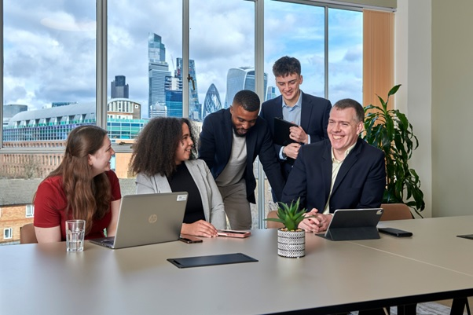
Milla Mazilu - Reflections on eight years at APM
APM has grown steadily over eight years. In 2016, we had 23,000 individual members, we now have over 45,000 members.
Increased involvement with government, and a renewed international focus, with new networks being created in the Middle East and Ireland.

Slide 7
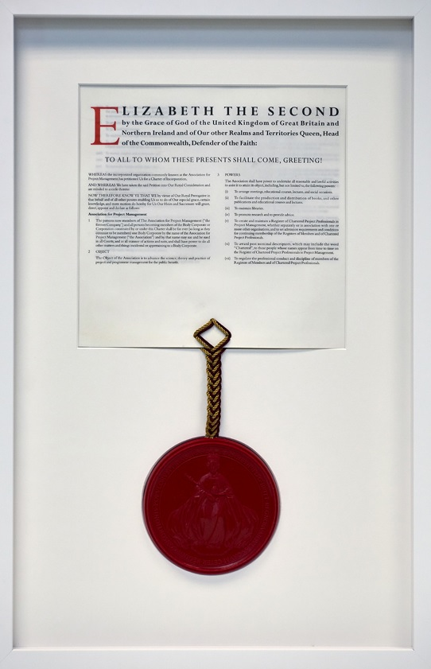
Chartership
APM was awarded its Royal Charter in 2017 by HM Queen Elizabeth II.
The Royal Charter is an internationally recognised mark of quality, and it has provided us with the platform to raise awareness of our skills, improve industry standards and develop our practice for the benefit of all in the profession.
There are now over 4,000 Chartered Project Professionals (ChPPs).

Slide 8


APM’s 50th anniversary
APM was founded in 1972.
We celebrated our 50th anniversary with a successful marketing campaign that celebrated the impact of projects from the past, present and for the future.
Our organisational rebrand was launched at this time, featuring changes to our logo, colour palette, fonts and visual elements. We evolved our brand to reflect the organisation we’ve become.

Slide 9

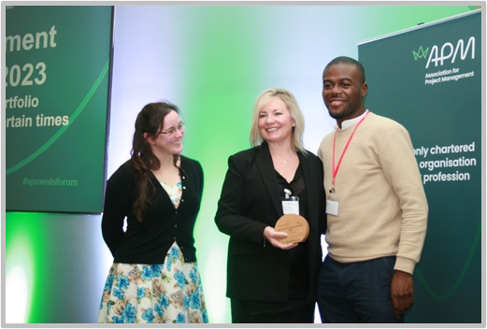
An outstanding organisation
Best Companies has recognised APM as an ‘outstanding’ organisation in recent years, first awarding APM a 1 Star accreditation before moving up to 2 Star in 2023.
There has been a focus on implementing diversity, equity, inclusion and belonging initiatives throughout the organisation.
We established the Volunteer Awards in 2017 to recognise the contributions our volunteers make to the success of APM and wider project profession. This forms part of our modernised volunteer offering,

Slide 10
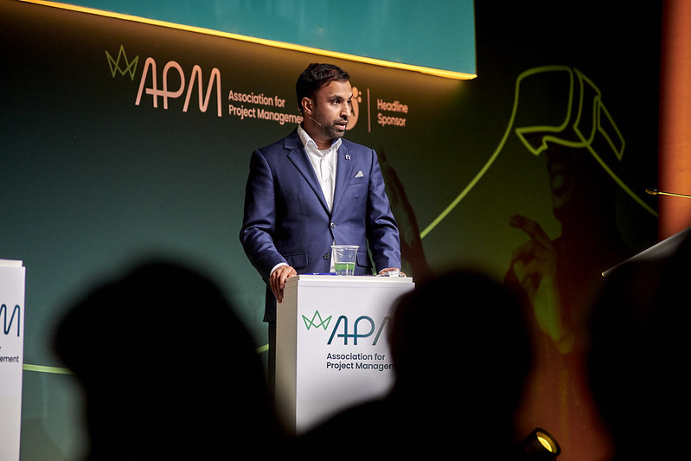

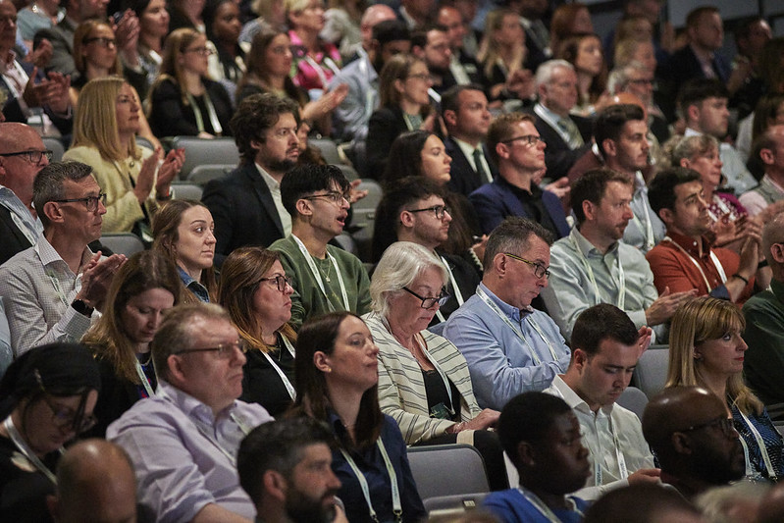
Events and Awards
Annual APM conference – over 500 attendees on each of the two days in 2024.
Women in Project Management conference – a shared success between APM volunteers and staff.
APM Awards – reflecting our commitment to recognising excellence, innovation, and achievement.

Slide 11




Looking Ahead
‘A world where all projects succeed.’
Continued growth – domestic and international.
Chartered Project Professional standard becoming the international standard.

Slide 12
Review of 2023/24 - major achievements
Professor Adam Boddison OBE, Chief Executive

Slide 13
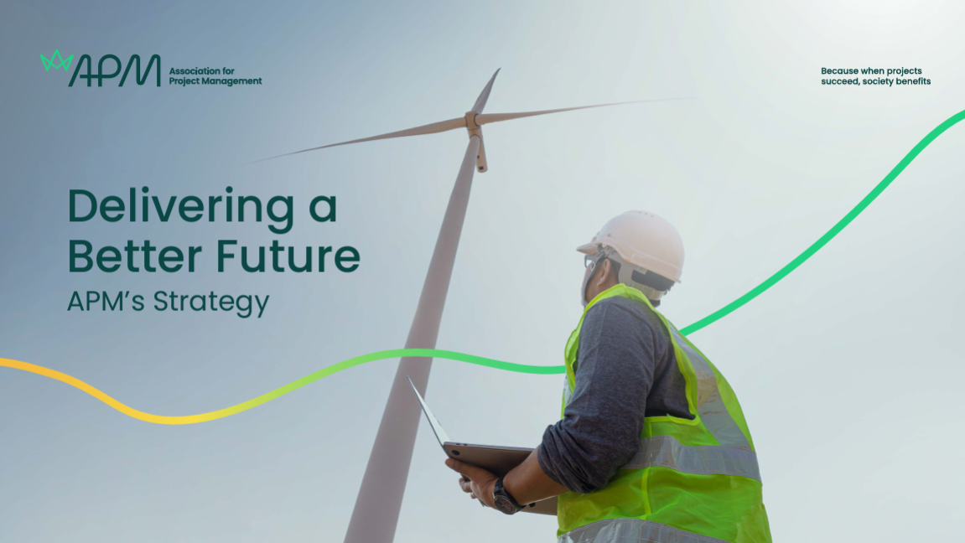
2023/24 highlights
Our 2023/24 business year saw a continued focus on our strategy, Delivering a Better Future. The strategic themes of this are:
APM provides leadership of the profession
APM is a professional body for all project professionals
APM identifies and enables the right skills for the project professional
APM is an outstanding professional body
By achieving these goals, more project, programme, and portfolio professionals can be at their best, and more projects will be delivered successfully.

Slide 14
2023/24 growth
Last year was our most successful revenue year ever with approximately £16 million revenue. We expect this to continue growing into 2025.
Membership increase to April 2024:
Individual: 3.4% growth to 45,767 members.
Corporate: 6.6% growth to 471 members
Chartership increase:
2023/24: Near 3,500
Social media increase:
Start of FY 2023/24: Overall followers 169,529
End of FY 2023/24: Overall followers 220,635
25,053 APM exams were sat last year - the most ever in a single year.

Slide 15

Making learning accessible – Changes to ChPP
We announced our new pathway to Chartered Project Professional (ChPP) status in January 2024, to give more project professionals the opportunity to undertake the journey to chartership.
The new pathway (launched in September) recognises validated professional practice built globally through qualifications and experiences in organisations across the profession, making chartered status accessible to more project practitioners (including those who hold the APM Project Management Qualification and the Project Management Institute PMP certification).
We may be multiple professional bodies, but we represent one profession.

Slide 16

Making learning accessible…
Changes to the Project Management Qualification
We laid the groundwork for the launch of our new Project Management Qualification, which launched in September 2024.
The updates drew from a wide range of consultation, research and insight-gathering, including the largest pilot of a new qualification by APM to date.
The new qualifications benefit from a new exam format that assesses a candidate’s project management knowledge through four new question types that are designed to be accessible, minimising barriers – particularly for neurodivergent candidates and those for whom English is a second language.

Slide 17

Why the changes?
These changes are part of a wider push to provide greater value for as many people as possible. We’re making changes that are ‘vital for some people, but valuable for all’ and making these part of our ordinarily-available provision.
Accessibility doesn’t have to be complicated. It can be about simple things like incorporating movement breaks into exams, having a variety of question types, or being able to tailor a chartership application to your own area of expertise.
This is part of the overall evolution of APM – improving accessibility and inclusion for everyone.

Slide 18
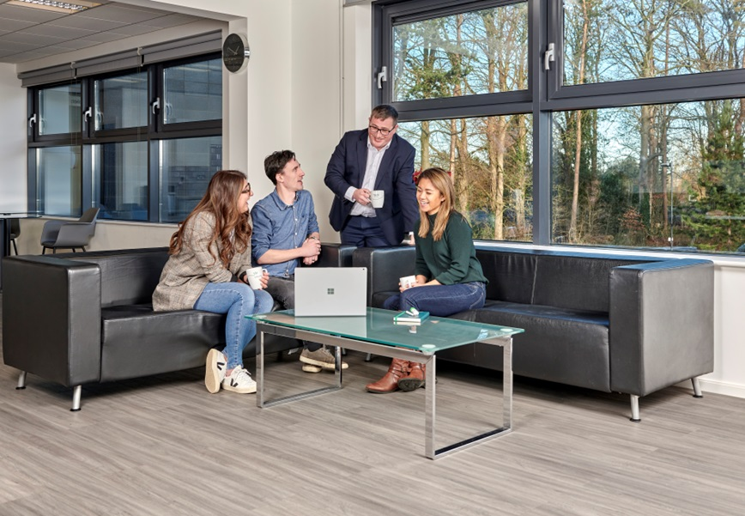
An outstanding professional body
For the second year running we achieved a 2 Star Best Companies rating. This represents an ‘outstanding’ level of workplace engagement.
During 2023/24, we focused on growth opportunities by:
introducing a coaching culture
Revamping our performance management approach
Our efforts to support diversity, equity, inclusion, and belonging (DEIB) have been bolstered through additional training for our menopause and DEIB champions.
Notes:
Coaching is giving people the opportunity to focus on what they want and how they will get there, while fostering personal and professional development. We’ll continue to build on this initiative during 2024/25.

Slide 19
Collaborating with other organisations
Chartered Institution of Civil Engineering Surveyors (CICES)
We signed a memorandum of understanding with the CICES to provide a basis for joint action in areas of common interest to those in the project management and civil engineering surveying industries.
Green Project Management (GPM Global)
We also announced our partnership with GPM Global, marking a commitment between both organisations to use our strengths and resources to advance sustainable and regenerative project management practices.
AI in the Project Profession
We produced a series of case studies looking at how organisations are adopting and using AI in their operations. These were produced in collaboration with organisations including Network Rail, Gleeds and MIGSO-PCUBED.

Slide 20
Engaging with government
We created our manifesto, ‘Respond, Reinvent, Reform. APM’s asks for the next UK Government’, to enable us to work more closely with the Government. We’ve already used this manifesto to shape our responses to Government announcements, including the 2023 Budget. We also attended the party conferences of all the major UK parties in 2023, including hosting our first fringe events at party conferences.
We've continued to strengthen our working relationship with the Infrastructure and Projects Authority (IPA), the government's centre of expertise for infrastructure and major projects. Between June and July 2023, we jointly exhibited at Civil Service Live - the government’s annual staff learning conference - with the IPA to engage and support project professionals within the civil service. More recently, we partnered with the IPA in March 2024 to produce the report Data Analytics and AI in Government Project Delivery.

Slide 21
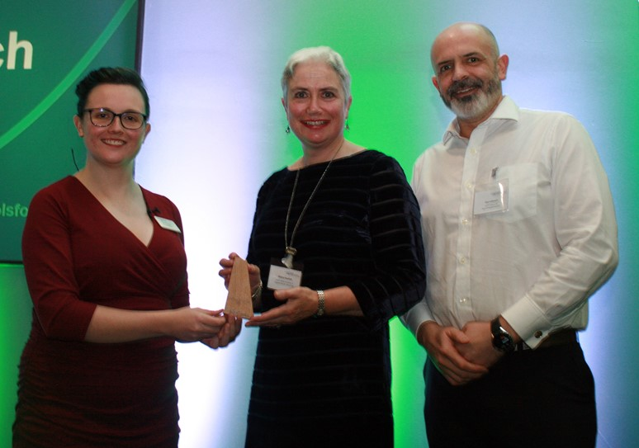
Thank you volunteers
Our volunteers were a huge part of our success during 2023/24. We’re extremely grateful for everything they do to support APM and the wider profession.
Last year, we conducted a volunteer review to find ways to create greater visibility, accessibility and opportunities for our volunteers. This resulted in the introduction of Regional Networks an Interest Networks, with new structures and roles. Changes were rolled out the changes in April 2024.
Our Volunteer Achievement Awards in November 2023 to recognised the invaluable contribution volunteers make to APM’s success. We’re looking forward to this year’s Awards.

Slide 22
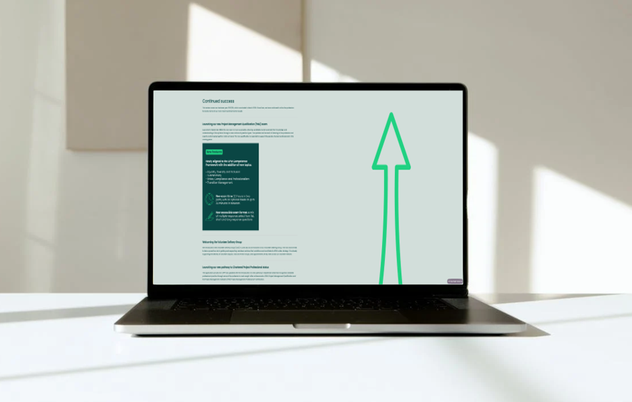
New-look Members’ Review
We’ve just published our latest Members’ Review, which summarises these and other highlights from our business year 2023/24 and beyond.
For the first time, we’ve published this report as an interactive online document.
Please take a look
apm.org.uk/about-us/apm-members-review
or Google “APM members review”

Slide 23

Looking ahead
‘We will continue to pursue our 1-10-100’ ambition:
• 1,000 Corporate Partners
• 10,000 Chartered Project Professionals
• 100,000 individual members
Our Body of Knowledge will see its 8th edition published in 2025.
We will continue investing in our employees by giving them more opportunities to support worthy causes through volunteering and charitable work.

Slide 24
2023/24 Financial Report
Mark Hepworth, Deputy Chief Executive Officer

Slide 25
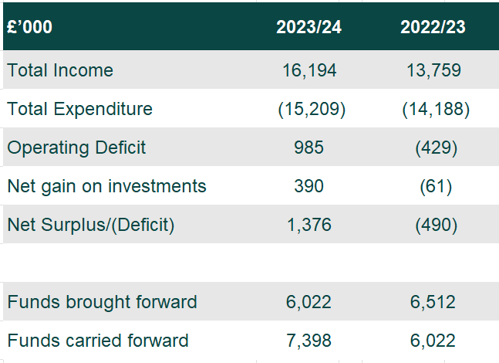
Income and Expenditure
Year to 31 March 2024
Notes:
Income grew by 18% to £16.2m from £13.8m prior year
Surplus of £1.4m against a prior year deficit £490k, invest in future strategy including technology update
Investment gain of £390k, v prior year loss of 61k, due to easing inflation, more stable interest rate policies, macroeconomic conditions
Net assets as at 31 March 2024 were £7.4m up £1.4m (the surplus!) on previous year
Income better than expected by £518k, driven by quals (£697k) and Chartered (£240k) offset by lower than expected in other areas
Expenditure £558k less than planned; combination of deferred activity due to the later than expected CRM implementation (software licences, depreciation), quals dev as we focussed on PMQ/ChPP new pathway, + some over-estimation of requirements and cost savings.
At the end of March, APM had net assets of £7.4m including cash and term deposits of £2.98m and the investment portfolio at £5.5m.

Slide 26
Income
Year to 31 March 2024
Notes:
Overall income up £2.4m, 18% on last year
Quals contributing 57% of total income, membership 35%
Qualification and contractual income around £1.5m (20%) higher than last year, to £9.3m from £7.8m
PMQ remains the primary driver of exam revenue with candidate numbers now surpassing pre-Covid levels
Membership up 17% on previous year from £4.8m to £5.6m
Individual membership grew 3.4%, reaching an all-time high of 45,767
Publishing downturn: unreasonable compliance issues with trading with Amazon
Event income increased by £93k (22%) benefiting from a second consecutive year of fully resumed in person events
Income from dividends and bank deposit interest more than doubled from £54k to £121k in the year due to sustained high interest rates, improved macroeconomic stability
94,826
54,333
94,826
54,333

Slide 27
Expenditure
Year to 31 March 2024
Notes:
Total costs rose by 7% in the year to £15.2m from £14.2m – mainly driven by inflationary pressures and the hiring of additional staff to support new strategic initiatives
Average headcount increased from 130 to 138 (+£608k)
R&D project expenditure was £200k less than previous year, as 22/23 included two large strategic projects; rebrand £190k + 50th anniversary (£81k)
Governance cost+£18k (7%), (£276k v £258k previous year), as more face-to-face meetings were held (+ £45k travel, venue costs)
Depreciation was down £64k on the previous year cost which included the final writing down of the online examination platform (introduced in 2020)
For the second year we achieved a two-star Best Companies rating (identifies best companies to work for in the UK), this represents an ‘outstanding level of workplace engagement.

Slide 28
Individual Membership
5 years to 31 March 2024
Membership Growth
  Averaging 9% cumulative growth each year
Notes:
Individual membership increased from 44,241 to 45,767 (1,526 increase) – record high
29,091 paying (see below) + 16,676 students
Student membership remained stable (-32 on previous year)
International members account for 6%
Corporates closed year at 471
9% cumulative growth ………
Net change in year
Full + 481
Associate +1,020
Fellow + 57
Students - 32
Total increase 1,526

Slide 29
Balance Sheet
As at 31 March
Notes:
Total assets held at the end of March were £7.4m. Reserves defined range increased to £5.5m to £9.8m, to reflect significant growth of the organisation over the last three years (was £3.3m to £6.9m)
Intangible fixed assets increase of £500k predominately reflects the development work on the replacement CRM
Deposit account balances are now presented under ‘cash at bank’ rather than investments (c£1.5m transferred)
Related party transactions; for Chartered assessments: £18k to Sheilina + £250 James White
Ibis gift aided surplus of £114k from sponsorship income to APM

Slide 30

Armistice Day
Two Minute Silence
11am 11th November 2024

Slide 31
Agenda Item 4
Election results
Mike Robinson, Company Secretary

Slide 32
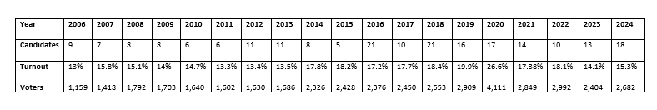
APM election results 2024
APM is very grateful for the high levels of interest and engagement; this really helps improve our governance.
Eighteen standing – an excellent number and calibre of candidates once again.
Turnout was 15.3% reflecting good levels of engagement. The ballot delivers proxy votes to the AGM. We can confirm three new appointments, each with three-year terms of office.

Slide 33
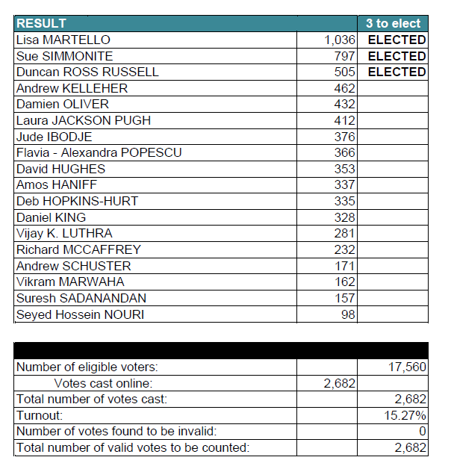

APM Election Results 2024

Slide 34
Agenda Item 5
Members questions
Professor Adam Boddison OBE, Chief Executive

Slide 35
Members’ written questions
Question by Tom Taylor
We are seeing the APM membership, marketplace and overall PM community expand considerably and successfully. How is the APM organisation keeping pace with this growth? For example, are figures available for the following in recent years, and looking forward:
Number of FTE staff
Number of APM members per member of staff
Total revenue per member of staff
Staff retention rates
Please provide any available benchmarking with other professional bodies for this data.
Answer
APM’s 1/10/100 ambitions demonstrate a commitment to growth, and as we grow our membership and Chartered holders, our organisation is expanding to support that increase. This isn’t and won’t be a linear relationship, particularly as we are investing in technology to increase efficiency, but also because we are developing different areas of our operations at different rates. For example, compared to pre-Covid, income has grown by well over a quarter, whilst staff numbers have risen by a sixth.
Employee numbers are recorded in our annual report and accounts, and these include comparisons to the prior year (see note 8 to the accounts). For 2023/24 the number was 138 and 2022/23 130. Membership numbers and revenue are also stated in the report and accounts. These were 45,767 / 44,241 and £16.2m / £13.8m respectively. Income per member was therefore £354 / £311 and income per FTE was £117k / £106k.
Ratios of member and revenue to staff provide little useful comparison between professional bodies. There is limited correlation between organisations, as factors such as size, ratio of paying/non-paying members, sources of income and nature of activities (and the extent to which these are income generating) vary significantly. Other than engineering and accountancy, there tends to be only one principal body representing each profession, so direct comparisons are difficult. That said, APM’s measures are not out of the ordinary when compared to our peers and our income growth is very high, so our ratios are increasing at a higher rate.
At 96% in 2023/24, staff retention is notably higher than the UK average and in line with the median for our benchmark organisations. This reflects our high level of staff engagement measured through Best Companies.

Slide 36
Members’ written questions
Question by Tom Taylor
    Diversity is important and topical in all fields. Does APM monitor and report on diversity for staff and volunteers as part of its diversity and equality policies? What are the trends? Thank you.
Answer
Yes, we monitor staff diversity data as much as possible but there is still work to do on this. There is more information in the main annual report around this. The trends are around intersectionality, belonging and neurodivergence, designing things for everyone so that all can feel included i.e. inclusive designs. APM has a diverse workforce and we strive for an environment where everyone feels values and respected no matter who they are. Current staff statistics are as follows:
Gender – 71% female 29% male
Ethnicity – 15% from an ethnic majority background
Disability – 22.8% evenly spread between cognitive, mental health and physical.
Age – 9% 18-25yrs, 28% 26-35yrs, 26% 36-45yrs, 33% 46- 59yrs, 4% over 60.
For volunteers, the team actively monitor diversity statistics. Currently. many respondents choose to select ‘prefer not to say’ so data is limited. Efforts are underway to improve data captured in My APM so that better data is available from mid-2025. See also the answer on volunteer diversity from the next question.

Slide 37
Members’ written questions
Question by Tamsin Alli-Balogun
Is there a current initiative or plan to monitor and improve gender and ethnic diversity across all oversubscribed APM volunteer activities (including conference speakers, Awards judges and committees)?
Answer
We value diversity and inclusion as core principles across all APM activities. We have made a concerted effort to increase the diversity of our volunteer community, ensuring that all our volunteering opportunities are more accessible and inclusive. We actively strive to ensure representation from different backgrounds, experiences, and perspectives in all our volunteering activities.
Our flagship conference speakers are selected with a commitment to balanced representation of different genders, ethnicities and backgrounds. For our Awards, while we may not always have detailed information on ethnicity or gender of those who put themselves forward as judges, we aim to make each judging panel as diverse as possible based on the information available.
We have also been encouraging our volunteer groups who curate APM event programmes (such as Regional Network and Interest Network conferences) to broaden their usual networks when suggesting speakers, ensuring greater diversity in our speaker line-ups. We will continue to emphasise this practice consistently moving forward. While we have seen progress, we acknowledge that certain areas, such as evening CPD events led by Volunteer Networks and student events involving Education Ambassadors, may have less diverse representation. However, we plan to monitor the diversity of volunteers involved in these activities over time, to improve representation in these areas.
We recognise that there is still room for improvement. Often, the challenge lies in the lack of diversity of the pool of individuals who put themselves forward for a specific activity. This means we need to strengthen our outreach and promotion efforts towards underrepresented groups. We are committed to continually assessing our approach to fostering greater diversity, particularly within our most visible and influential volunteer positions, and we welcome any suggestions to support this process. Of course, we welcome interest in APM volunteering form all sections of the community.

Slide 38
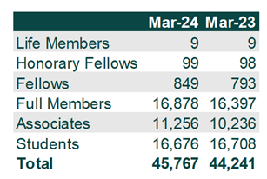
Members’ written questions
Question by Ian Koenig
The number of student members was excluded from this year’s annual report. Can you please provide at the AGM.
Answer

Slide 39
Final thoughts and closing remarks
Dr Yvonne Thompson CBE, President
Milla Mazilu BEM, Chair

Slide 40
Thank you.

